Slide 1
186.143 Informationsvisualisierung
Alicka Ewald - 1612992
Ozge Ozkaya - 12326273

Slide 2
Initial Question/Hypothesis
Hypothesis: Researchers can benefit from a visualization tool that demonstrates funding trends on specific topics on Health. A tool can assist them to see funders, funded organizations and the amount on specific topics.
Question: Where and when did NIH-funds flow into? Can we see trends for different countries, years or funding topics?
Objective:
Create a tool for researchers to analyze which areas are funded, who funds them, and who receives the funding, enhancing transparency and aiding in informed decision-making.
Ideally, create a center for them to track trends, and reach out to the funders and fund receivers.

Slide 3
Dataset
The National Institutes of Health (NIH) is a part of the U.S. Department of Health and Human Services and is the primary federal agency for conducting and supporting medical research
NIH-funded projects (2019-2023)
A vast fundamental collection of databases comprise the synergistic knowledge base for NIH research. (source)
Information on funded projects, organizations, received amount, funder organization and such
Original size: +400k
Used size: +4k

Slide 4
Feature | Description
APPLICATION_ID | Unique identifier for the research grant application.
FY | Fiscal year of the grant.
ED_INST_TYPE | Type of educational institution.
IC_NAME | Name of the NIH Institute or Center providing the funding.
NIH_SPENDING_CATS | NIH spending categories.
ORG_CITY | City where the recipient organization is located.
ORG_COUNTRY | Country of the recipient organization.
ORG_DEPT | Department within the recipient organization.
ORG_NAME | Name of the recipient organization.
PHR | Public Health Relevance statement.
PROJECT_TERMS | Terms and keywords related to the project.
PROJECT_TITLE | Title of the funded project.
TOTAL_COST | Total cost of the grant.

Slide 5
Pre-processıng
Dataset merging and modelling
Data cleaning and transformation
Handling missing values
Structuring data for visualization

Slide 6
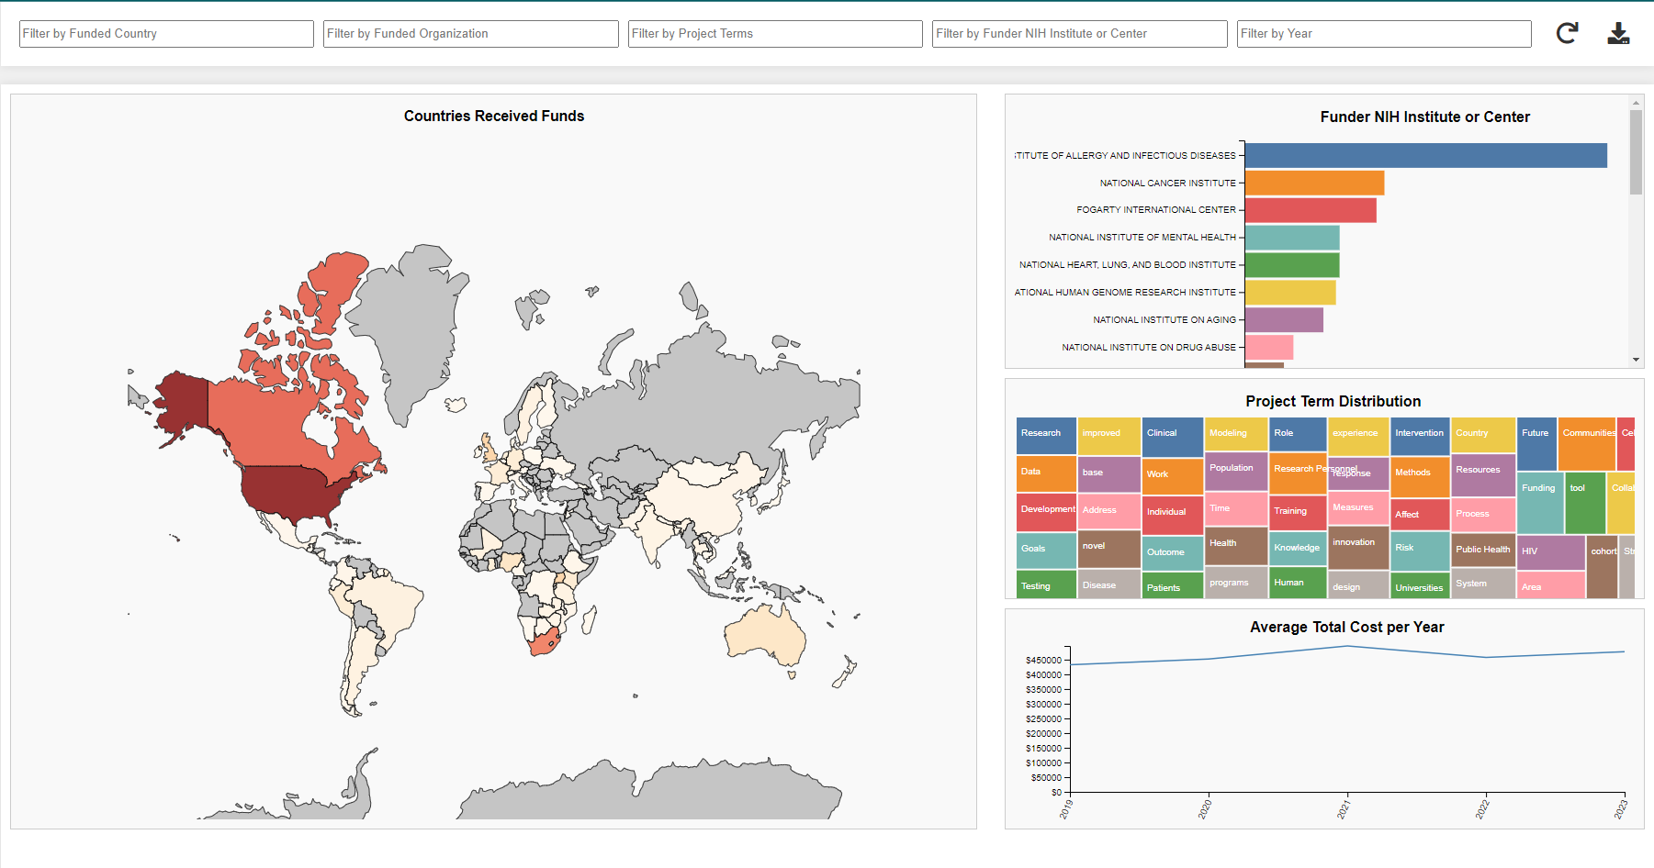
Visualızatıon method/ınteractıon
Charts
World map
Bar chart on funder institutes
Treemap on funded project topics
Line chart on funded amount
Filtering by
Funded organization country
Funded organization
Funder organization
Funder NIH institute or Center
Year
Download data
Entire dataset
Filtered dataset

Slide 7
Implementation
Tools used:
HTML/CSS/JS
D3.js
Python for data analysis
Platform
Deployed to GitHub pages: https://ozgeozkaya.github.io/IV3---NIH-Tracker/

Slide 8
Answers to initial question/hypotesis
Findings:
Detailed trends in funding distribution
Identification of funding sources and receivers
Insights to funded research areas
Tracking amount of funds, organizations and the countries
Confirmation:
Tool demonstrates funding trends and provides valuable insights for researchers
Visualizes areas, organizations funded by NIH

